Slide 1
The Growing E-Waste Crisis Siobhan Doherty CIS311: Technical Writing Post University Computer Information Systems Professors Franklin Orellana and Louis Unger April 5, 2026

Slide 2
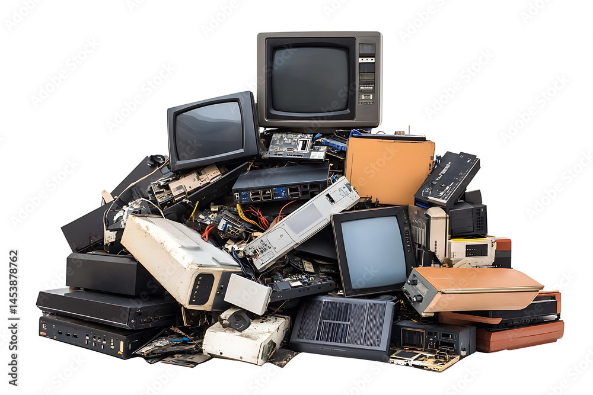
E‑Waste and Environmental Impact
• E‑waste refers to discarded electronic devices such as phones, computers, and appliances
• Rapid technological advancement and short product lifecycles drive global e‑waste growth
• Improper disposal introduces hazardous materials into the environment
• E‑waste poses long‑term environmental and sustainability challenges
(Widmer et al., 2005)
Notes:
E‑waste is old electronics like phones and computers that people throw away. Because devices are replaced so quickly, e‑waste is growing and can seriously harm the environment if not handled properly (Widmer et al., 2005). SJB Studio. (n.d.). Pile of discarded obsolete electronic devices (e‑waste) on transparent background [Stock photograph]. Adobe Stock. https://stock.adobe.com/images/pile-of-discarded-obsolete-electronic-devices-e-waste-on-transparent-background/1453878762
(Widmer et al., 2005)

Slide 3
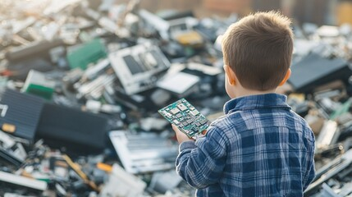
Environmental and Health Impacts
• Toxic substances from e‑waste contaminate air, soil, and water
• Informal recycling and dumping expose communities to serious health risks
• Documented impacts include neurological damage and respiratory illness
• Environmental harms disproportionately affect vulnerable populations
(Andeobu et al., 2023)
Notes:
Improper e‑waste disposal releases toxic chemicals into the air, soil, and water. This can cause serious health problems, especially for vulnerable communities (Andeobu et al., 2023).
(Andeobu et al., 2023)
Electronic waste (e‑waste) recycling concept [Stock photograph]. (n.d.). Adobe Stock. https://as2.ftcdn.net/v2/jpg/11/24/54/43/1000_F_1124544343_huPSVu1pMgxaHqxrgRiKZyqK6Kljbtwy.jpg

Slide 4

Manufacturer Responsibility
• Extended Producer Responsibility (EPR) policies assign manufacturers responsibility for end‑of‑life electronics
• EPR programs improve collection, recycling, and eco‑design practices
• Manufacturer participation is critical to effective e‑waste management systems
• Producer accountability supports sustainable waste reduction
(Leclerc & Badami, 2023)
Notes:
Manufacturers are responsible for managing e‑waste through Extended Producer Responsibility policies. These policies help improve recycling and reduce waste through better product design (Leclerc & Badami, 2023).
(Leclerc & Badami, 2023)
Pile of discarded obsolete electronic devices (e‑waste) on transparent background. (n.d.). [Photograph]. Adobe Stock. https://as1.ftcdn.net/v2/jpg/17/73/79/72/1000_F_1773797261_AmVPoL29crbZnDvjwE9raA9tDZgXQlJi.jpg

Slide 5

Consumer Role in Reducing E‑Waste
• Consumer awareness influences recycling and disposal behavior
• Proper e‑waste handling reduces environmental and health risks
• Reuse, repair, and responsible purchasing extend product life
• Informed consumers contribute to circular economy goals
(Islam et al., 2021)
Notes:
Consumers can reduce e‑waste by recycling electronics, repairing devices, and buying less. These actions help extend product life and protect the environment (Islam et al., 2021).
Electronic waste (e‑waste) recycling concept. (n.d.). [Photograph]. Adobe Stock. https://t4.ftcdn.net/jpg/19/41/67/49/240_F_1941674938_YIpXRjlPhN3oc1czwubqzBuRDaLV5QbK.jpg
(Islam et al., 2021)

Slide 6

Influencing Sustainable Change
• Consumers can pressure companies to adopt sustainable production practices
• Policy, education, and corporate responsibility drive e‑waste solutions
• Sustainable management promotes environmental justice
• Collaboration among stakeholders is essential for long‑term impact
(Ogunseitan, 2023)
Notes:
Consumers can push companies to be more sustainable through education, policies, and responsible purchasing. Working together helps reduce environmental harm and supports environmental justice (Ogunseitan, 2023).
Electronic waste (e‑waste) recycling concept. (n.d.). [Photograph]. Adobe Stock. https://as1.ftcdn.net/v2/jpg/18/44/09/24/1000_F_1844092424_DTOcqyyA0lFp8fkxM01iN5tmEle6KYVA.jpg
(Ogunseitan, 2023)

Slide 7
References:
Adobe. (n.d.). Adobe Stock. https://stock.adobe.com/
Andeobu, L., Wibowo, S., & Grandhi, S. (2023). Environmental and health consequences of e‑waste dumping and recycling carried out by selected countries in Asia and Latin America. Sustainability, 15(13), Article 10405. https://doi.org/10.3390/su151310405
Islam, M. T., Huda, N., Sahajwalla, V., Baumber, A., Shumon, R., & Zaman, A. (2021). A global review of consumer behavior towards e‑waste and implications for the circular economy. Journal of Cleaner Production, 316, 128297. https://doi.org/10.1016/j.jclepro.2021.128297
Leclerc, S. H., & Badami, M. G. (2023). Extended producer responsibility: An empirical investigation into municipalities’ contributions to and perspectives on e‑waste management. Environmental Policy and Governance, 33(4), 356–371. https://doi.org/10.1002/eet.2059
Ogunseitan, O. A. (2023). The environmental justice agenda for e‑waste management. Environment: Science and Policy for Sustainable Development, 65(2), 15–25. https://doi.org/10.1080/00139157.2023.2167457
Widmer, R., Oswald‑Krapf, H., Sinha‑Khetriwal, D., Schnellmann, M., & Böni, H. (2005). Global perspectives on e‑waste. Environmental Impact Assessment Review, 25(5), 436–458. https://doi.org/10.1016/j.eiar.2005.04.001

